Slide 1
PyTorch and CNNs

Slide 2
Agenda
Overview of AI and Deep Learning (17.15-17.25)
Datasets (17.25-17.30)
Task: Implement Dataset in Pytorch (17.30-17.40)
Solution (17.40-17.45)
CNNs
Convolution (17.45-18.00). Task (18.15-18.25). Solution (18.25-18.30)
Other Layers (18.30-18.35). Task (18.35 - 1845). Solution (1845-1850) (DROP)
Training Loop (18.50 - 19.00). Task (19.00-19.15). Solution (19.15-1920)
Specific CNN Architectures (19.20-19.25).
Competition: Create the most accuracy custom CNN! (19.25-20.00)

Slide 3

HELLO!
I AM ULRIK RØSBY
5. Year Computer Science
Writing master’s in Autonomous Driving
Earlier been Project lead in 2 projects at Cogito NTNU (Emojify, CatMatch)

Slide 4
Introduction
1
Welcome to deep learning

Slide 5
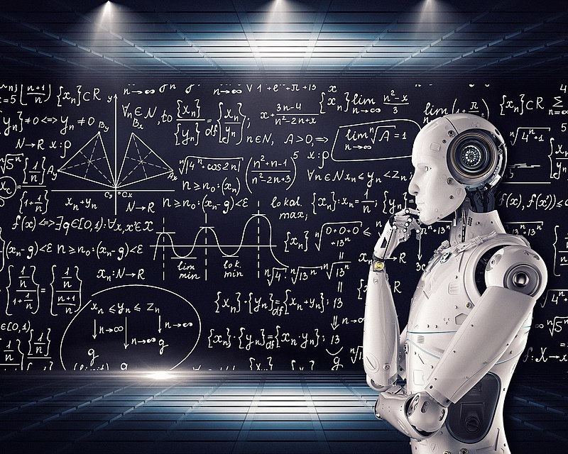
What is AI?
Defining AI is hard
John McCarthy:
“It is the science and engineering of making intelligent machines, especially intelligent computer programs.”
What is intelligence?
Doing the correct thing or something like that
Quote source: http://jmc.stanford.edu/artificial-intelligence/what-is-ai/index.html
Image source: https://upload.wikimedia.org/wikipedia/commons/thumb/9/9d/Artificial_intelligence_Reasoning%2C_problem-solving.jpg/800px-Artificial_intelligence_Reasoning%2C_problem-solving.jpg

Slide 6
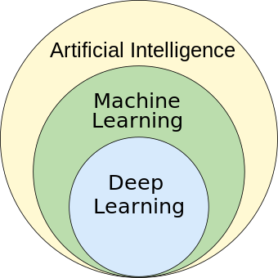
What is Deep Learning?
If statement
Linear regression
Neural networks
Image source: https://upload.wikimedia.org/wikipedia/commons/1/1b/AI_hierarchy.svg

Slide 7
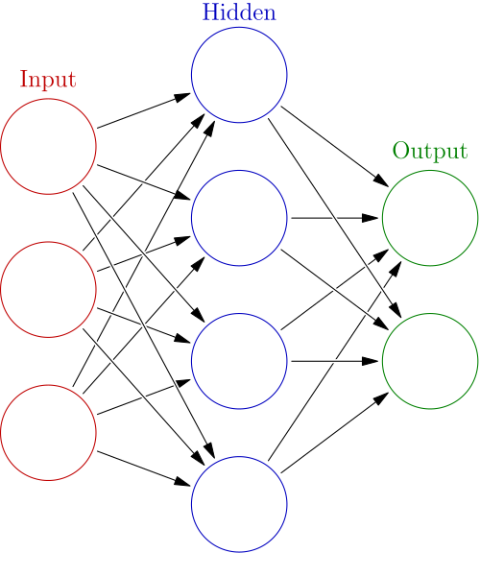
What is a Neural Network?
Often use Artificial Neural Network (ANN)
Consists of 3 parts
Input layer
Hidden layers
Output layer
Each layer consists of artificial neurons
a(x) = f(w·x + b)
x - input
w - learned weights
b - learned bias
f - activation function (chosen beforehand)
Image source: https://upload.wikimedia.org/wikipedia/commons/thumb/4/46/Colored_neural_network.svg/1200px-Colored_neural_network.svg.png

Slide 8
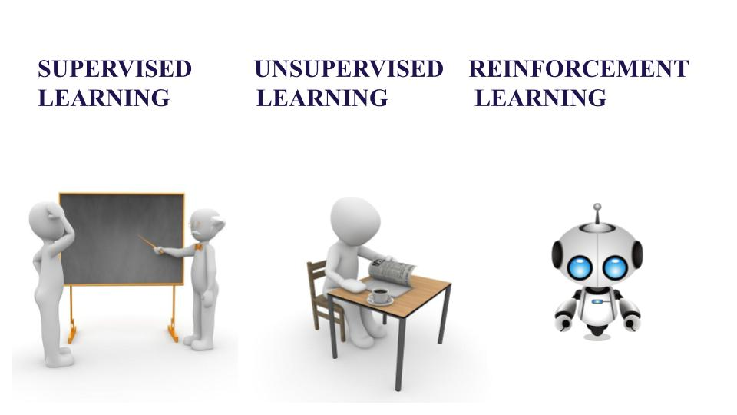
Training a neural network
3 main methods
Supervised Learning
We know the correct output
Unsupervised learning
We have no correct output
Reinforcement learning
Give the model a reward based on how correct it is
We will only care about supervised learning today
Image source: https://www.aitude.com/wp-content/uploads/2020/01/Untitled-presentation-1-1.jpg

Slide 9
What is a Neural Network? (2)
a(x) = f(w·x + b)
Steps for training a ANN with supervised learning
Randomly initialize the weights w and bias b.
Do a forward pass through the network (calculate the result for an input x). Thus obtain the predicted result ŷ.
Using the loss function L, calculate L(ŷ, y)
Do backpropagation to find the gradient in the network
Use the optimizer, like SGD, to use the gradient to optimize the weights
Repeat from 2. until satisfied
Image source: https://upload.wikimedia.org/wikipedia/commons/thumb/4/46/Colored_neural_network.svg/1200px-Colored_neural_network.svg.png

Slide 10
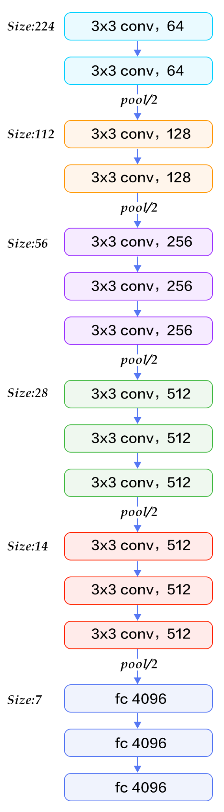
Architecture of a Neural Network
Architecture of VGG16 a CNN
Image source: https://www.kaggle.com/code/blurredmachine/vggnet-16-architecture-a-complete-guide

Slide 11
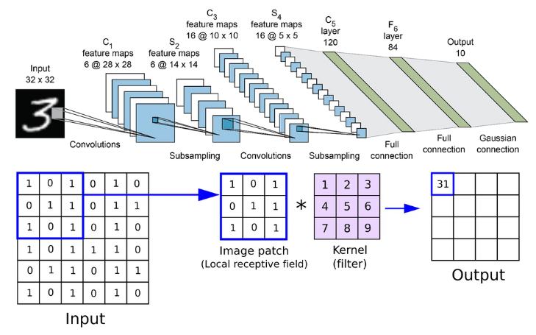
What is a CNN?
It is a method to analyze images in a neural network
Groups parts of the image to produce a smaller representation called a feature map
Image source: https://assets-global.website-files.com/614c82ed388d53640613982e/646371e3bdc5ca90dee5331b_convolutional-neural-network%20(1).webp

Slide 12
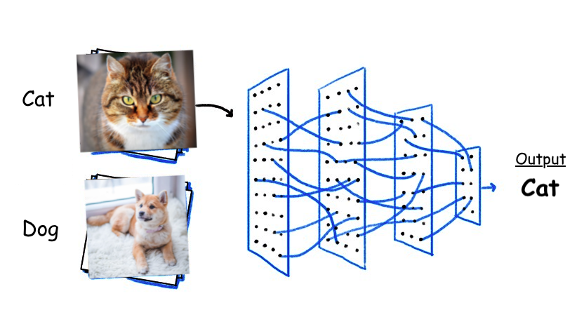
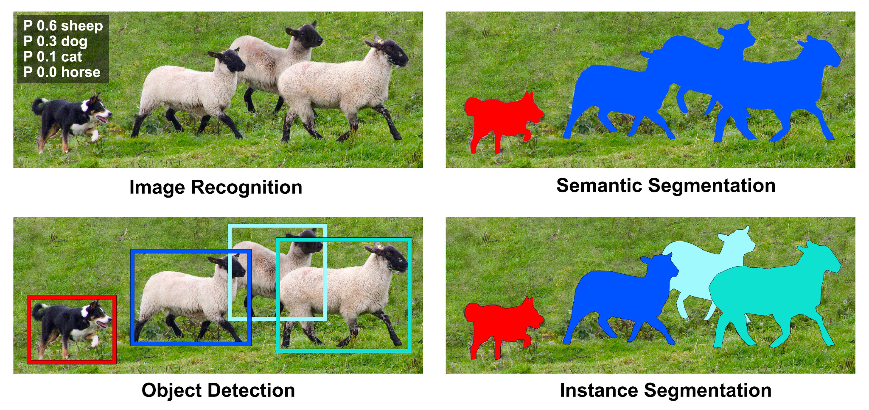
What can a CNN do? - examples
Object Detection
Semantic Segmenation
Classification
Image sources:
Left: https://towardsdatascience.com/10-papers-you-should-read-to-understand-image-classification-in-the-deep-learning-era-4b9d792f45a7
Middle and right: https://manipulation.csail.mit.edu/segmentation.html

Slide 13
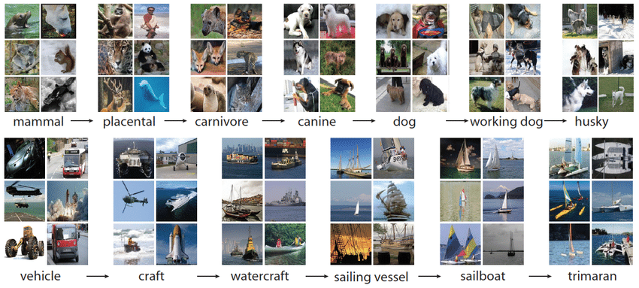
Datasets
ImageNet (14 mill labeled images)
Is a set of data that is used to train the model
Especially used in supervised learning to ensure having the “correct” values - ground truth
Image source: https://blog.roboflow.com/introduction-to-imagenet/

Slide 14
Typical datasets
Premade datasets (ImageNet, CIFAR100, Cityscapes, nuScenes…)
CSV files
Find open datasets on https://kaggle.com

Slide 15
Important aspects of datasets
Balanced distribution of data
Include all relevant situations
Large (usually several 1000 elements)
No annotation errors

Slide 16
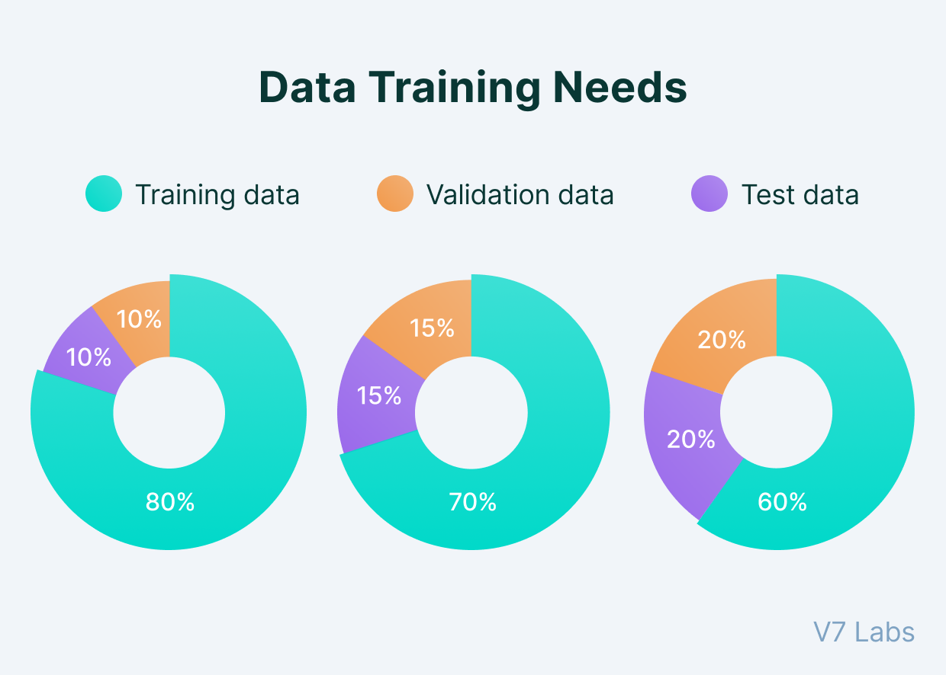
Processing of dataset during training
The dataset is split into
Training dataset (often 80%)
(Validation dataset) (often 10%)
Testing dataset (10% - 20%)
Processed in batches
Format the data to a way the model efficiently understands
Image source: https://www.v7labs.com/blog/train-validation-test-set

Slide 17

PyTorch
Is research industry standard library for deep learning
Includes all you tools you need to build, train and run a deep learning model
Also includes some premade and pretrained models in torchvision
Alternatives: Tensorflow, JAX
Image source: https://github.com/pytorch/pytorch/blob/main/docs/source/_static/img/pytorch-logo-dark.png

Slide 18
Datasets
2
What the model is learning from

Slide 19
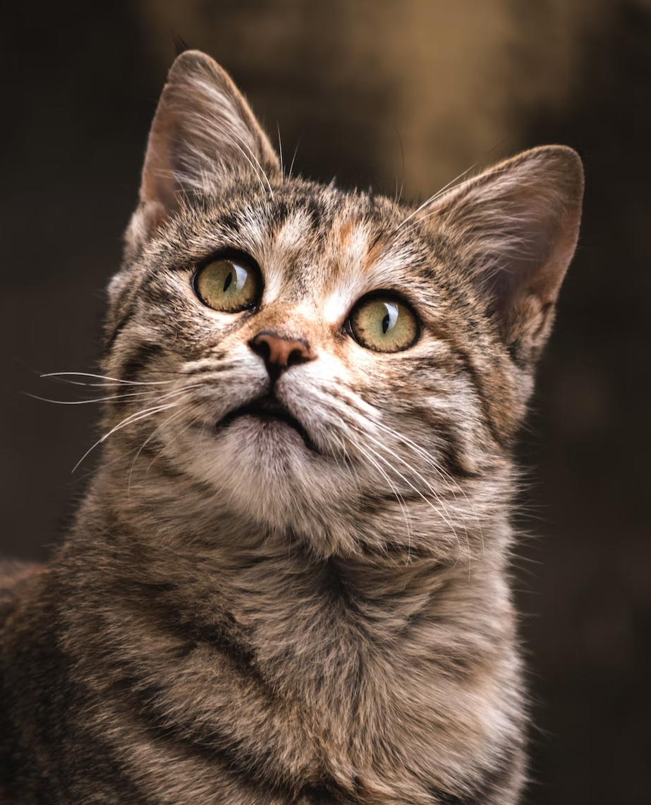
HOW TO REPRESENT DATA?

Slide 20

How to represent data?
Images
Each pixel is a vector of their red, green and blue value [255, 165, 0]
Thus a image that is 512 * 256 px has shape (512, 256, 3)
Labels
Numbers
If your labels are [“cat”, “dog”, “mouse”]
The labels are cat=1, dog=2, mouse=3 and are represented by position in an array in the network

Slide 21
Datasets in PyTorch
On to the Google Colab Notebook

Slide 22
CNNs
3
Convolutional Neural Networks

Slide 23

CONVOLUTION
Image source: https://medium.com/@nikitamalviya/convolution-pooling-f8e797898cf9

Slide 24
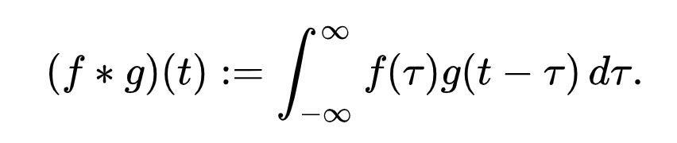
Convolution - the continuous math def
Source: en.wikipedia.org/wiki/Convolution

Slide 25

Convolution - mathematical definition
A way to combine two functions
Source: en.wikipedia.org/wiki/Convolution

Slide 26
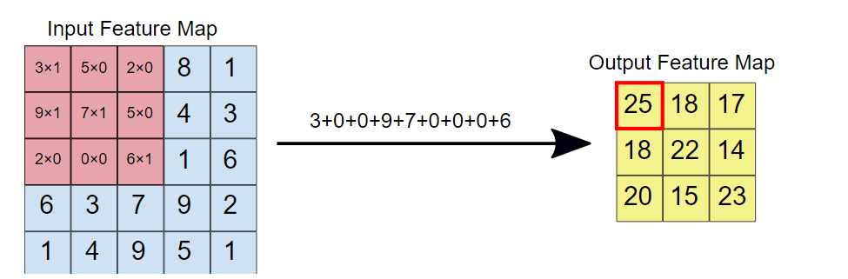
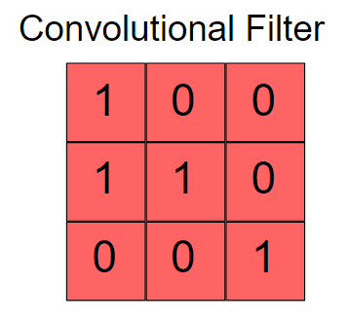
Convolution - on images
Image source: https://developers.google.com/machine-learning/practica/image-classification/convolutional-neural-networks

Slide 27

Convolution - on images
Image source: https://upload.wikimedia.org/wikipedia/commons/thumb/1/19/2D_Convolution_Animation.gif/330px-2D_Convolution_Animation.gif

Slide 28
Exercise!
Implement a convolution on an image!

Slide 29
Convolutional Layers
We are trying to find the kernel!
The weights in a convolutional layer denote the numbers that make up the kernel

Slide 30
Convolutional Neural Networks
A CNN is an ANN with at least one convolutional layer
Other layers:
Batch Normalization (BatchNorm)
Max Pool
A CNN outputs a feature map
A lower-dimensionality representation of the image

Slide 31
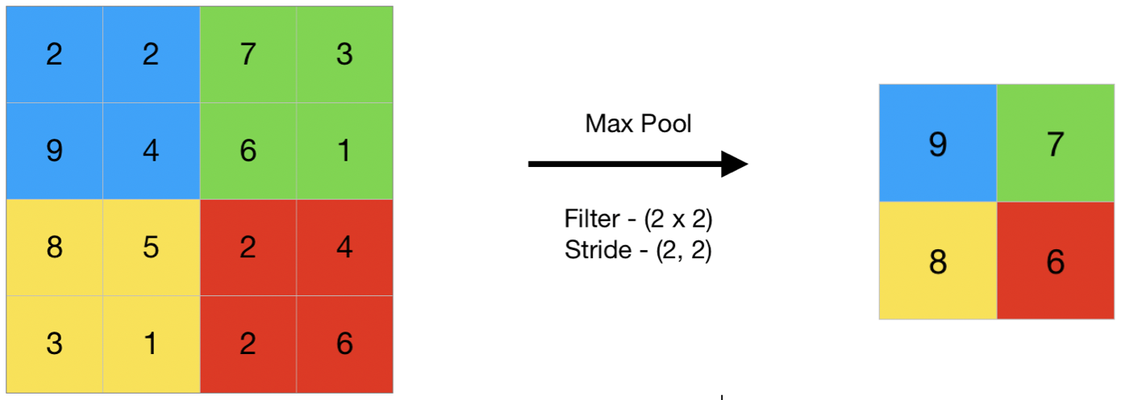
Max Pooling
Uses a n*n kernel and a stride
Goes through the matrix like convolution,
But chooses the maximum value instead
Image source: https://www.geeksforgeeks.org/cnn-introduction-to-pooling-layer/

Slide 32
Max Pooling - Task!
Let’s implement Max Pooling!

Slide 33
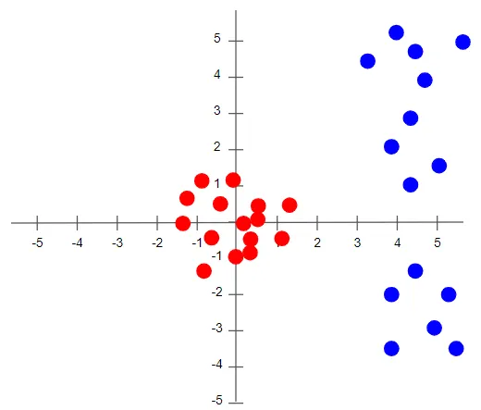
Batch Normalization
Uses re-centering and scaling to make ANNs faster and more stable
It normalizes the distribution of output values from the neurons
This way large values don’t impact the result that much
Image source: https://towardsdatascience.com/batch-norm-explained-visually-how-it-works-and-why-neural-networks-need-it-b18919692739

Slide 34
Training Loop
4
The most successful ones

Slide 35
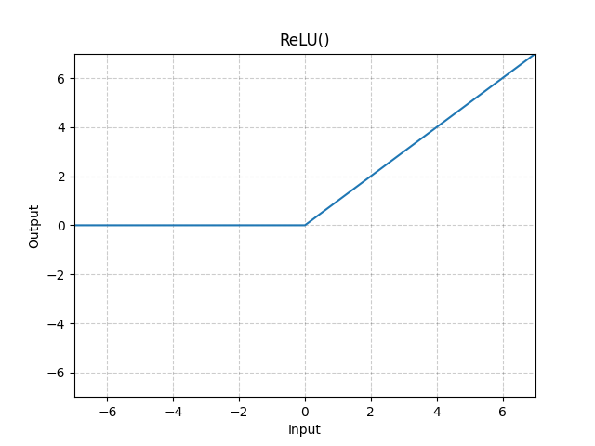
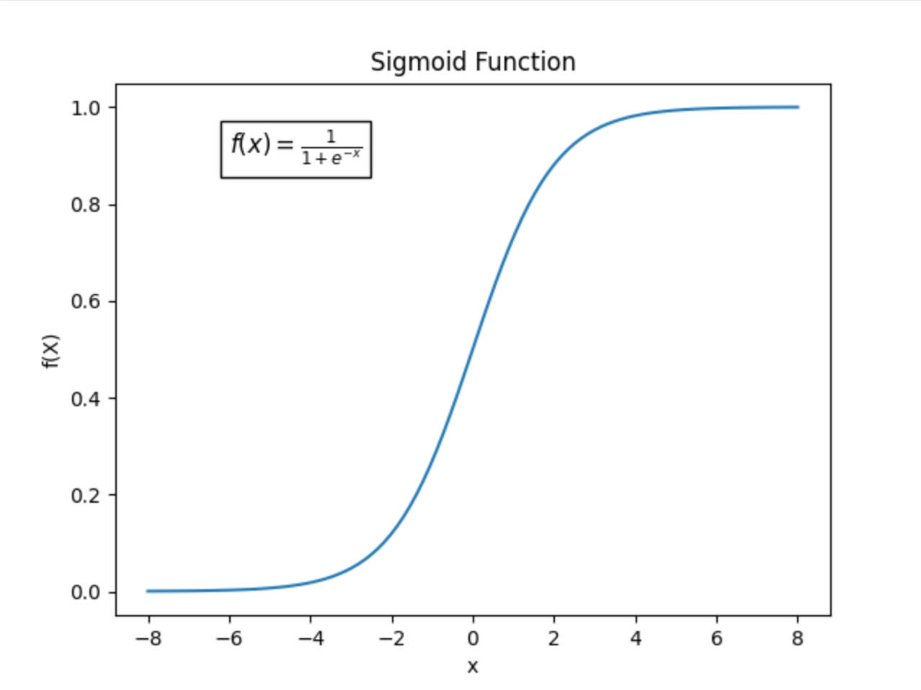
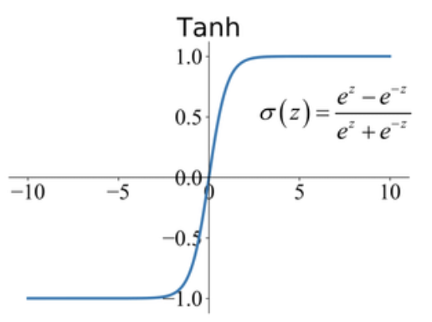
Neural Networks - Activation Functions
Introduces non-linearity into the network
a(x) = f(w·x + b)
Image source: Left: https://pytorch.org/docs/stable/_images/ReLU.png
Middle: https://raw.githubusercontent.com/Codecademy/docs/main/media/sigmoid-function.png Right: https://production-media.paperswithcode.com/methods/Screen_Shot_2020-05-27_at_4.23.22_PM_dcuMBJl.png

Slide 36
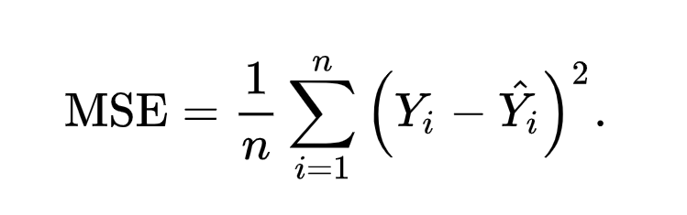
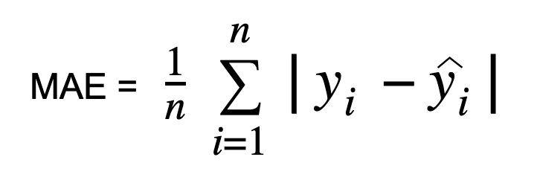
Neural Networks - Loss
Steps for training a ANN with supervised learning
Randomly initialize w and b.
Do a forward pass to obtain ŷ.
Calculate loss: L(ŷ, y)
Do backpropagation
Use the optimizer (e.g.) SGD to improve weights.
Repeat from 2. until satisfied
Are function that calculate how “wrong” the prediction is.
Their derivative decide the gradient
Examples (for regression):
Mean Squared Error
Mean Absolute Error
Image sources: Left: en.wikipedia.org/wiki/Mean_squared_error
Right: https://editor.analyticsvidhya.com/uploads/42439Screenshot%202021-10-26%20at%209.34.08%20PM.png

Slide 37
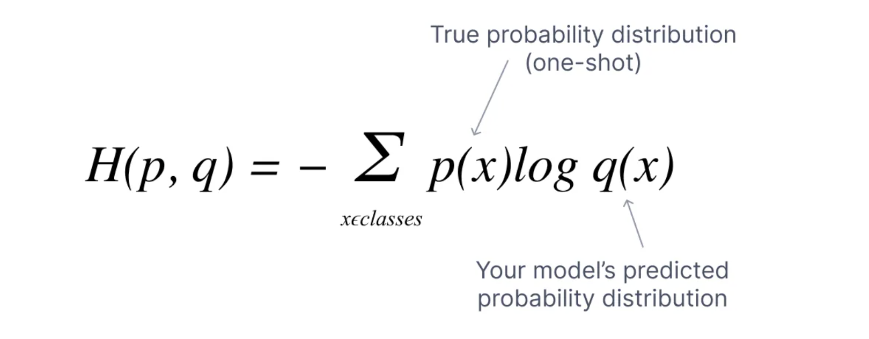
Neural Networks - Loss (2)
Steps for training a ANN with supervised learning
Randomly initialize w and b.
Do a forward pass to obtain ŷ.
Calculate loss: L(ŷ, y)
Do backpropagation
Use the optimizer (e.g.) SGD to improve weights.
Repeat from 2. until satisfied
For classification
Cross Entropy Loss
Image source: https://www.v7labs.com/blog/cross-entropy-loss-guide

Slide 38
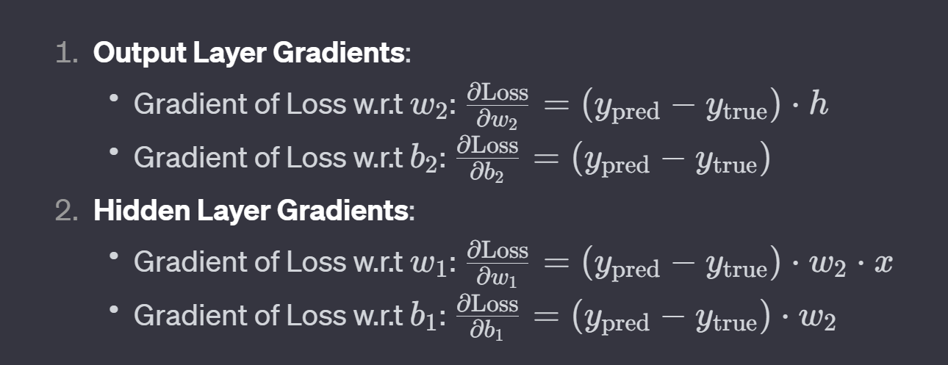
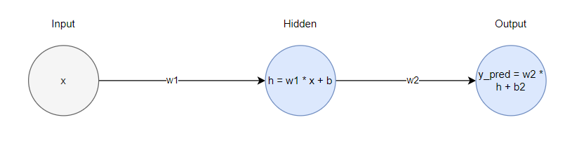
Neural Networks - Backpropagation
Steps for training a ANN with supervised learning
Randomly initialize w and b.
Do a forward pass to obtain ŷ.
Calculate loss: L(ŷ, y)
Do backpropagation
Use the optimizer (e.g.) SGD to improve weights.
Repeat from 2. until satisfied
Is an algorithm to compute the gradient on each network node with respect to the weights
(Using MSE as loss function)

Slide 39

Neural Networks - Optimizers
Steps for training a ANN with supervised learning
Randomly initialize w and b.
Do a forward pass to obtain ŷ.
Calculate loss: L(ŷ, y)
Do backpropagation
Use the optimizer (e.g.) SGD to improve weights.
Repeat from 2. until satisfied
Is the algorithm to update the weights given the gradient from backpropagation
Cost = Average Loss for entire dataset
Formula:
w_new = w - learning_rate * gradient
(learning_rate is a pre-decided hyperparamter)
Gradient Descent
Image source: https://www.analyticsvidhya.com/blog/2020/10/how-does-the-gradient-descent-algorithm-work-in-machine-learning/

Slide 40
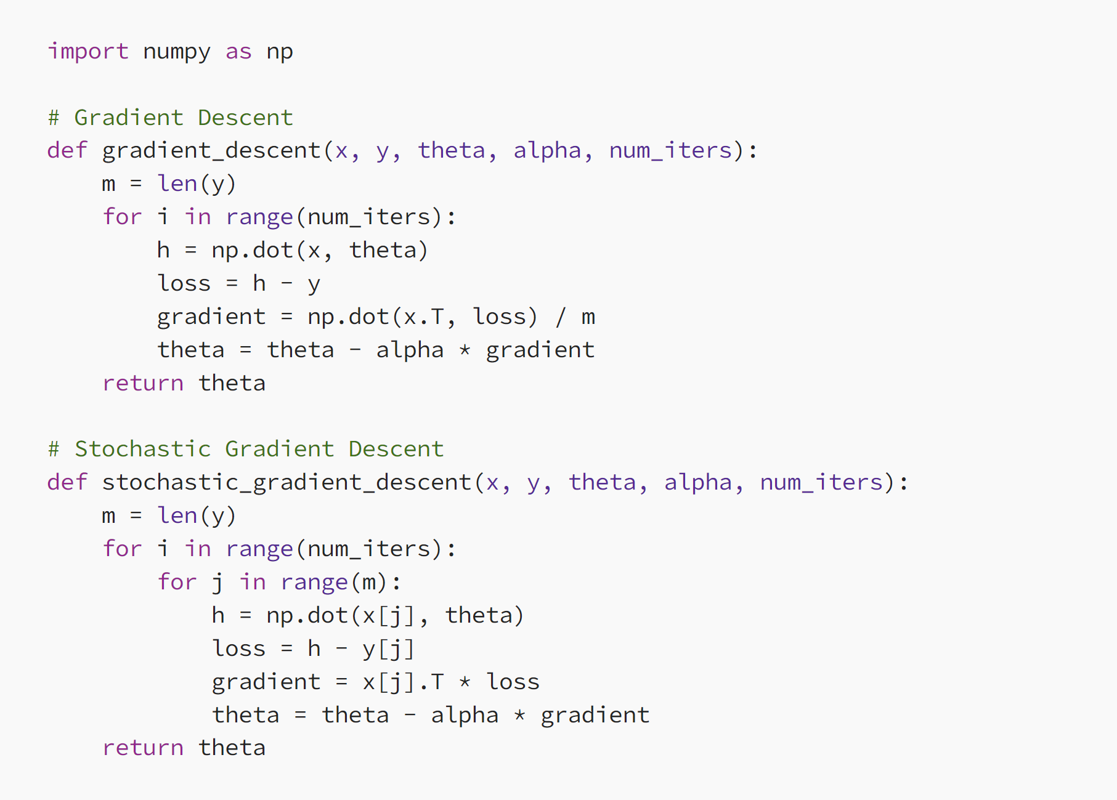
Neural Networks - Optimizers (2)
Steps for training a ANN with supervised learning
Randomly initialize w and b.
Do a forward pass to obtain ŷ.
Calculate loss: L(ŷ, y)
Do backpropagation
Use the optimizer (e.g.) SGD to improve weights.
Repeat from 2. until satisfied
Usually Stochastic Gradient Descent is used
Instead of using the average gradient for the entire dataset, uses the gradient from a small subset of the dataset
Code source: https://medium.com/@dhirendrachoudhary_96193/what-is-the-difference-between-stochastic-gradient-descent-sgd-and-gradient-descent-gd-10e7d8019018

Slide 41
Neural Networks - Optimizers (3)
Steps for training a ANN with supervised learning
Randomly initialize w and b.
Do a forward pass to obtain ŷ.
Calculate loss: L(ŷ, y)
Do backpropagation
Use the optimizer (e.g.) SGD to improve weights.
Repeat from 2. until satisfied
Other Optimizers
Adam
AdamW
Converge faster than SGD by using
Adaptive learning rate
AdamW has weight decay (to discourage large weights)

Slide 42
CNN training loop in PyTorch
Let’s see some code

Slide 43
Specific CNN Architectures
5
The most successful ones

Slide 44
VGG
Inputs 224 * 224 pixel RGB images
For ImageNet they cropped out the center 224*224 patch of the image
Composed of 16 layers
13 Convolutional 3 x 3 layers
Ends with 3 fully connected layers
Uses ReLU as the activation function
Image source: https://www.kaggle.com/code/blurredmachine/vggnet-16-architecture-a-complete-guide

Slide 45
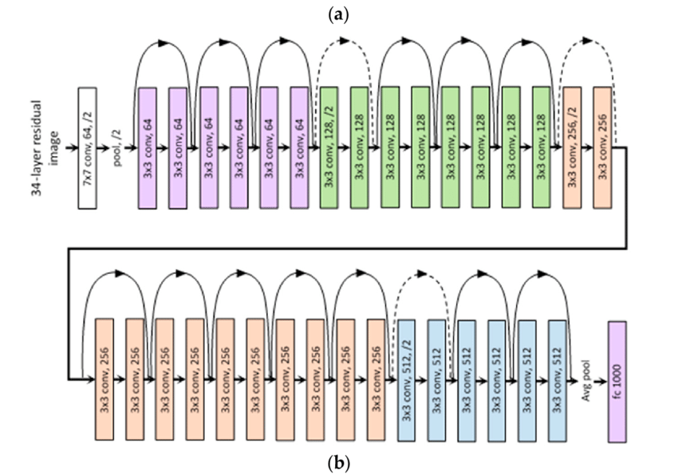
ResNet
Introduces the residual connection
Skips layers and adds a previous input to the current output.
Solves the vanishing gradients problem of deep neural networks
Image source: https://medium.com/@siddheshb008/resnet-architecture-explained-47309ea9283d
ResNet paper: https://arxiv.org/pdf/1512.03385.pdf

Slide 46
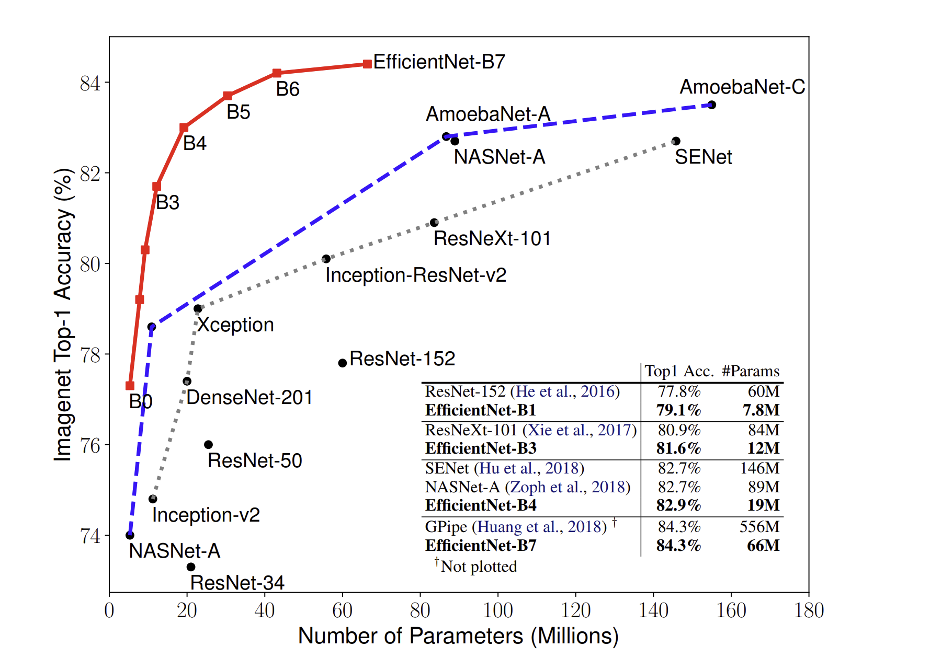
EfficientNet
A CNN that builds upon MobileNetV2 and uses MBConv layers
Introduces an optimal scaling of depth (number of layers) and width (number of neurons per layer) and image resolution by accuracy and desired parameters
The most efficient CNN if you want to use one
Image source and EfficientNet paper: arxiv.org/pdf/1905.11946.pdf

Slide 47
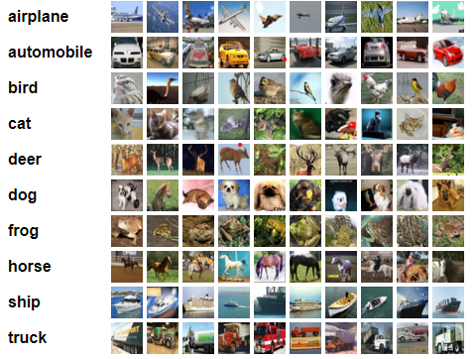
COMPETITION!
CIFAR10
Image source: https://www.cs.toronto.edu/~kriz/cifar.html

Slide 48
Competition: Accuracy on CIFAR10
Goal: Train and validate a custom CNN on the CIFAR10 dataset
Rules
You cannot use pretrained or prebuilt networks, like ResNet50 from torchvision
Use the last 20% of the dataset for testing. This data cannot be trained on. (See `cifar_test` and `cifar_trainable`)
You can only train on the trainable CIFAR10 data, and no other data.
You can create as big network as you choose using anything from torch.nn, as long as you build it yourself.
You have to complete the challenge within the time limit.

